Slide 1
HELOTES SWITCHING STATION & AUTOTRANSFORMER ADDITION AT EASTSIDE RPG PROJECT
PRESENTED BY:
Marcos Terrazas, PE
Transmission Planning & Operations Engineering
July 29, 2025

Slide 2
agenda
Project Overview
Project Need
Recommended Project

Slide 3
PROJECT OVERVIEW
Reliability driven Tier-1 Project
Driven by generation retirements local to CPS Energy and load growth.
Cost Estimate: $110M
Need By: 2028 Summer Peak
Expanding existing 138kV Helotes substation to a 345/138kV substation with two 600 MVA autotransformers.
Need By: 2029 Summer Peak
Addition of third autotransformer at Eastside 345/138kV switching station.

Slide 4
PROJECT NEED
Contingency Type | Monitored Element(s) | Rating MVA | 2028 Summer Peak (%) *
P1 Single | Hill Country Auto 3 & 4 | 600 | 103
 | Cagnon Auto 3 & 4 | 600 | 102
P6 | Hill Country Auto 3 & 4 | 660 | 103
 | Cagnon Auto 3 & 4 | 660 | 102
ERCOT3 Auto & Common Twr | Hill Country Auto 3 & 4 | 660 | 103
 | Cagnon Auto 3 & 4 | 660 | 102
Contingency Type | Monitored Element(s) | Rating MVA | 2029 Summer Peak (%) *
ERCOT3 Auto & Common Twr | Eastside Auto 1 and 2 | 660 | 110
Helotes 345/138kV Switching Station Mitigates the Hill Country and Cagnon Autotransformer Post-Contingency Overloads
Addition of a third autotransformer at Eastside switching station Mitigates the Eastside Autotransformer Post-Contingency Overloads
*Overloads defined as % of Facility rating
NERC and ERCOT criteria violations observed in Summer Peak 2028 and 2029

Slide 5
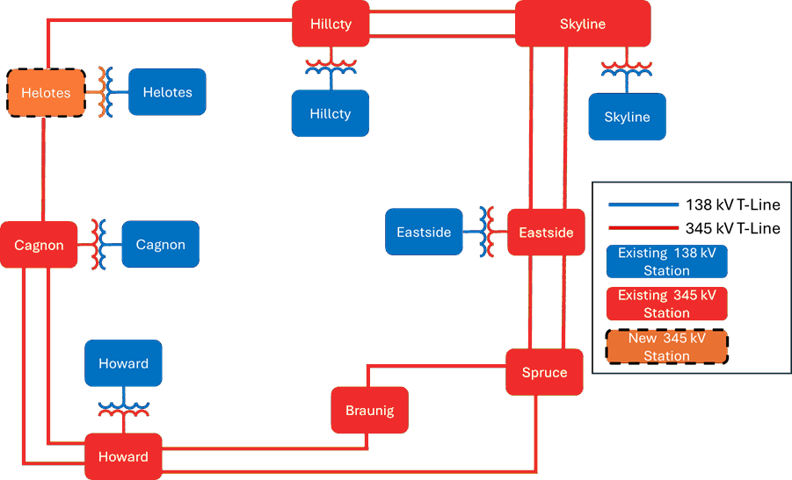
RECOMMENDED PROJECT
Expanding existing 138kV Helotes substation to a 345/138kV substation with two 600 MVA autotransformers.
Addition of a third autotransformer at Eastside switching station.
*

Slide 6
Thank you

